Slide 1
Error detection and Spline Interpolation of eye gaze data
Presenter: Martin Lee, UHID: 1985750
Instructor: Dr. Rishabh Sharma

Slide 2
Eye gaze data
Saccade:
Eye movement used to move the fovea rapidly from one point of interest to another.
Fixation:
The period of time where the eye is kept aligned period of time where the eye is kept aligned with the target for a certain duration.

Slide 3
Overview
Data collection
Preprocessing
Detect and invalidate outliers
Fill gaps

Slide 4
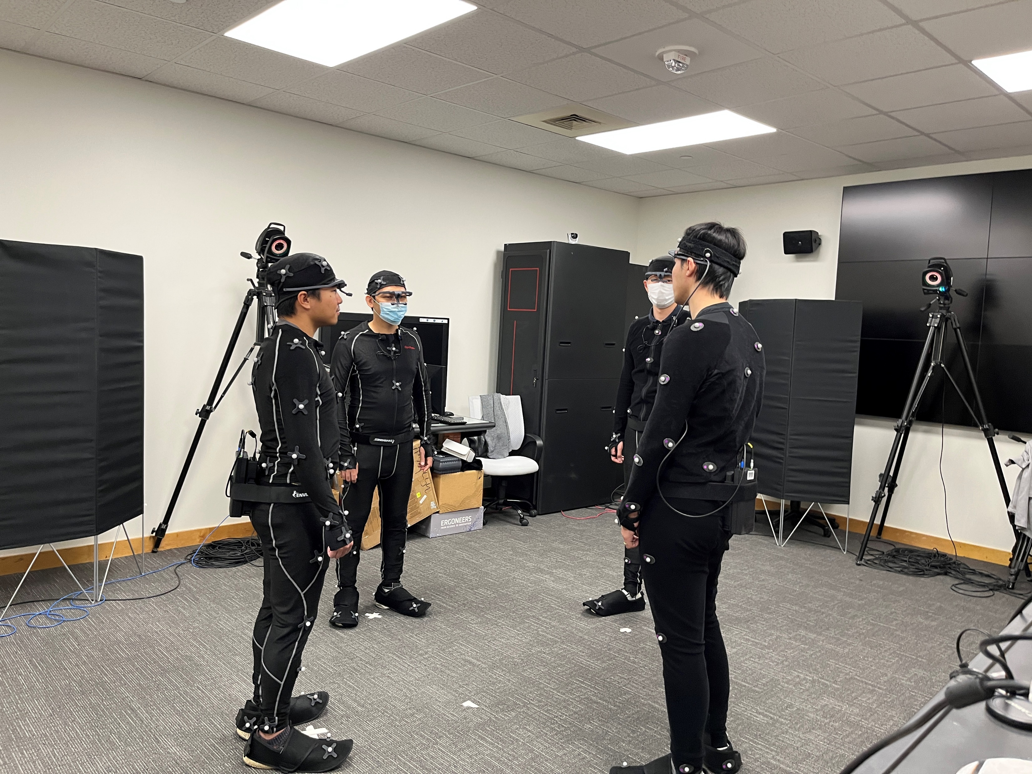
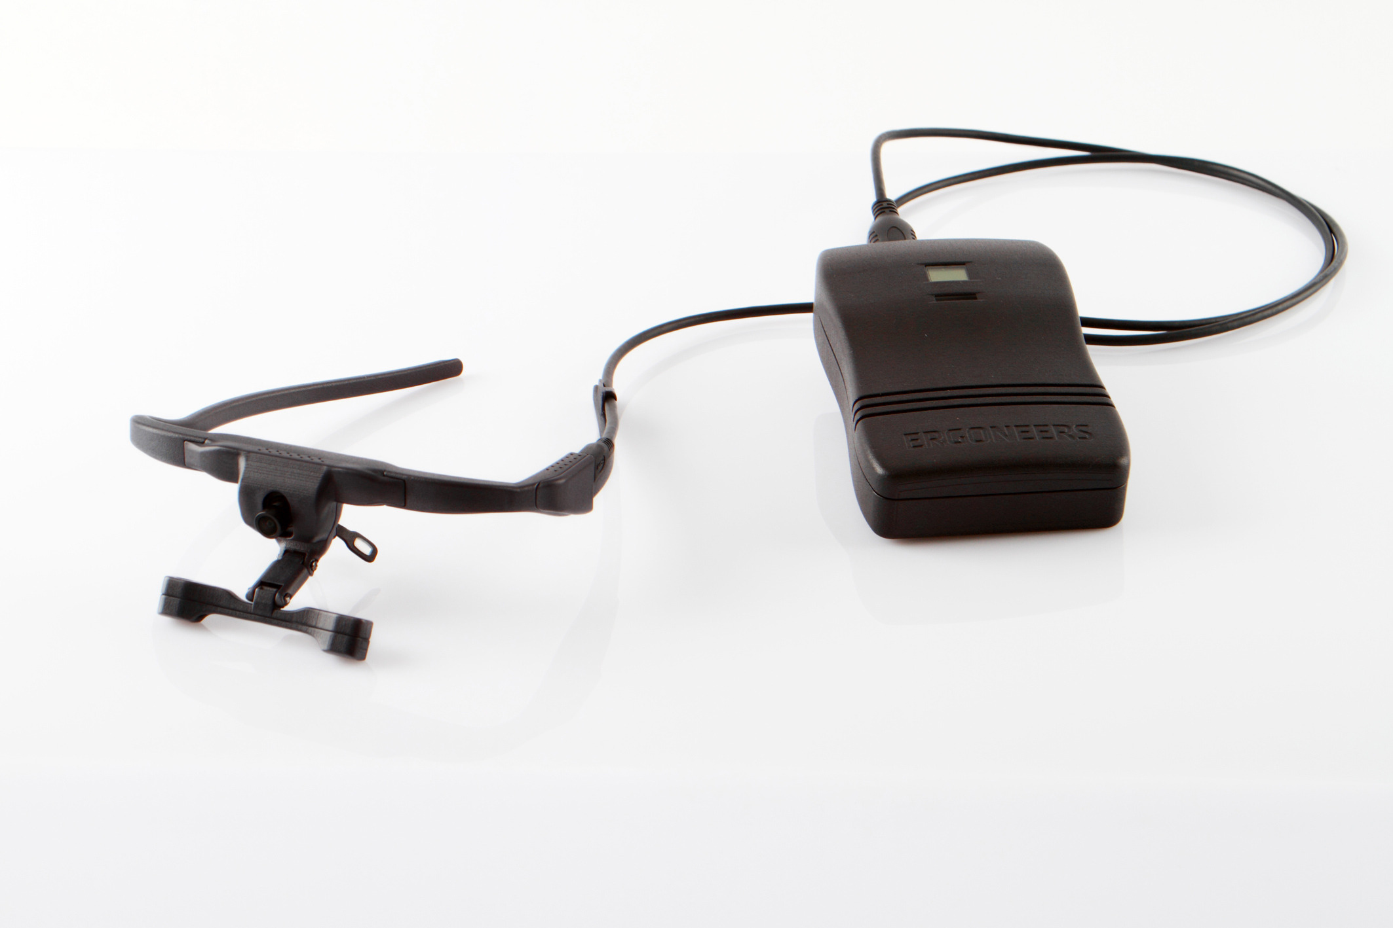
Data collection

Slide 5
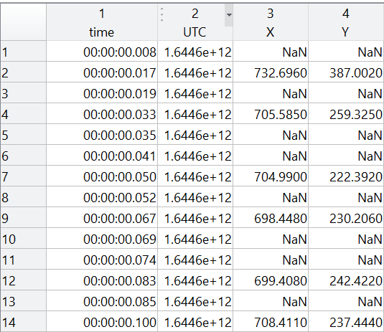
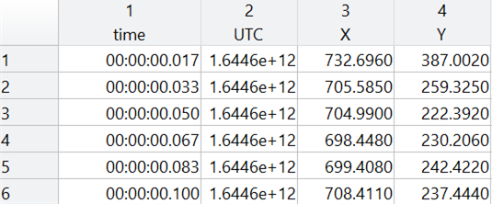
Preprocessing
Notes:
redundant

Slide 6
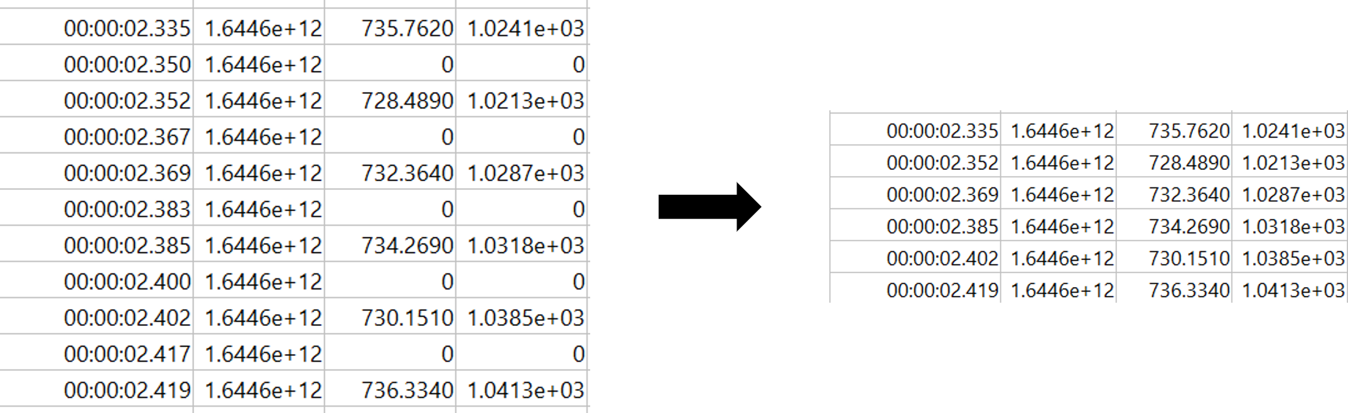
Preprocessing
Notes:
redundant

Slide 7
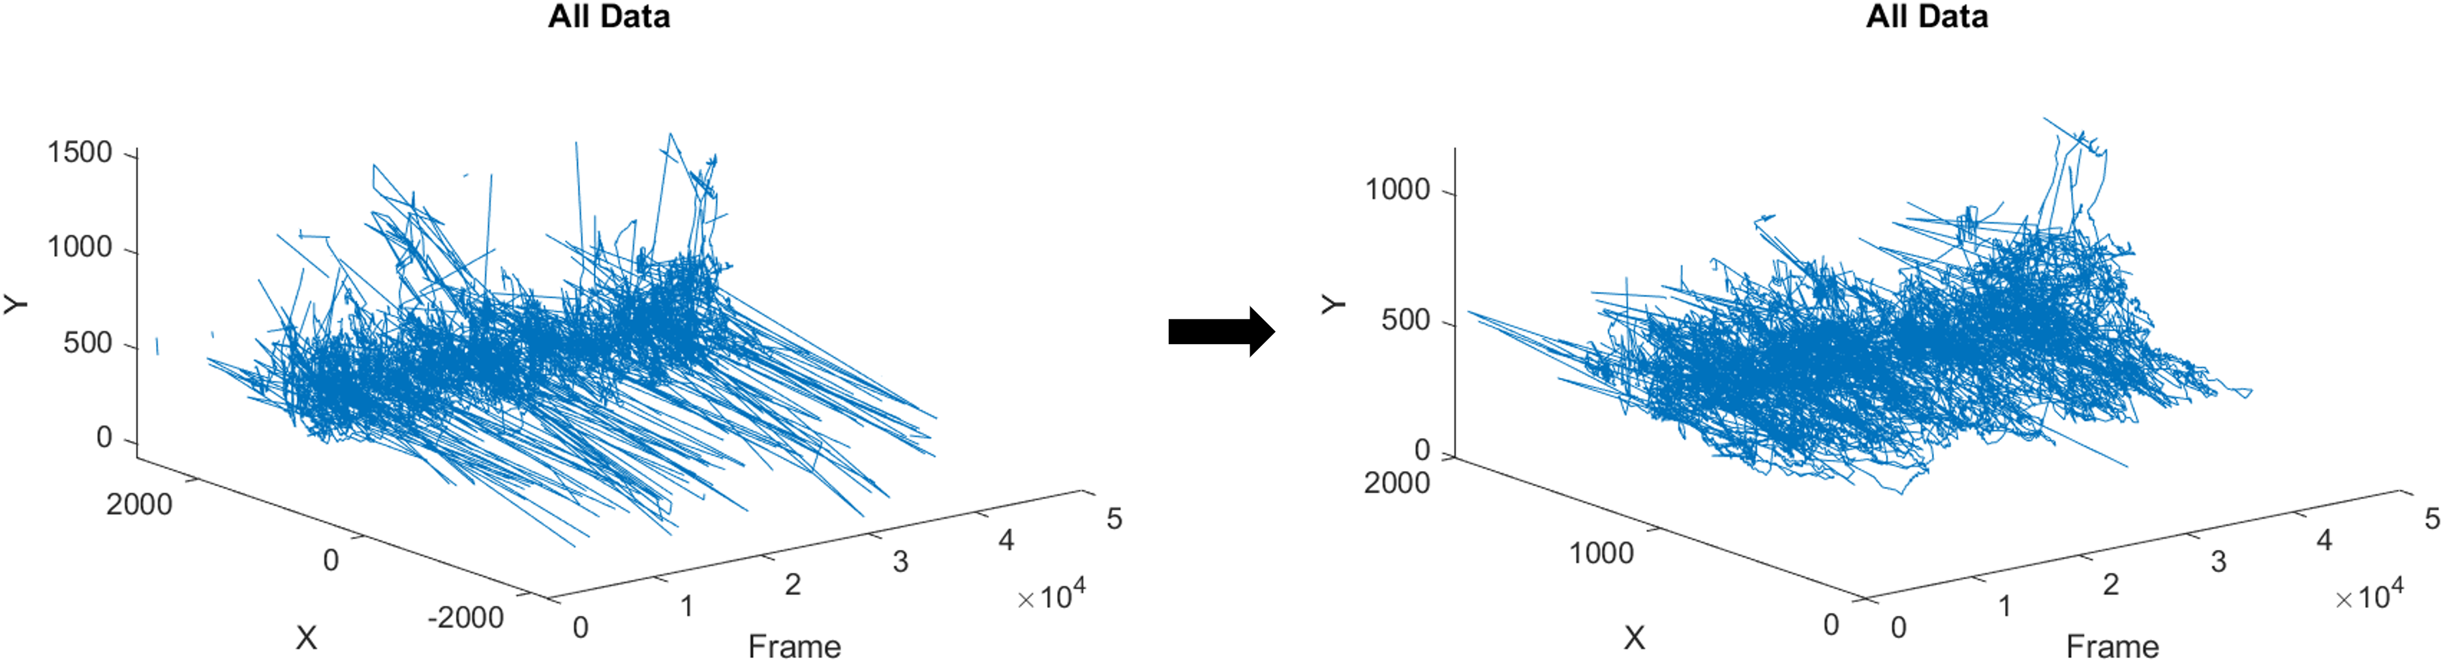
Detect and eliminate outliers
Notes:
redundant

Slide 8
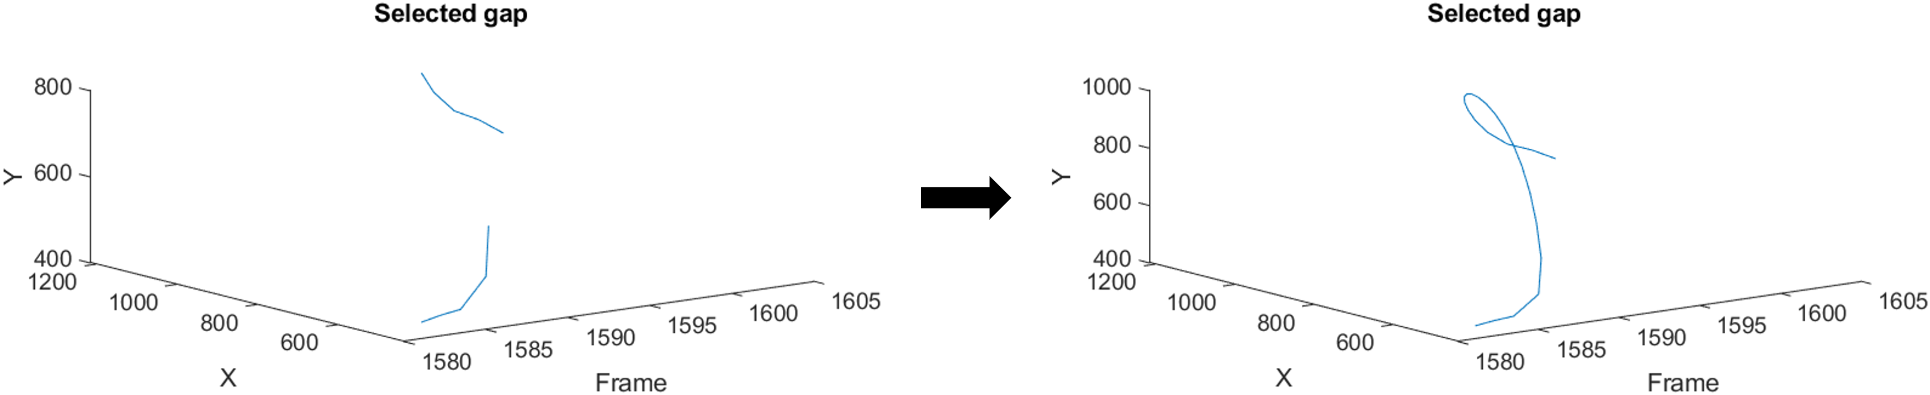
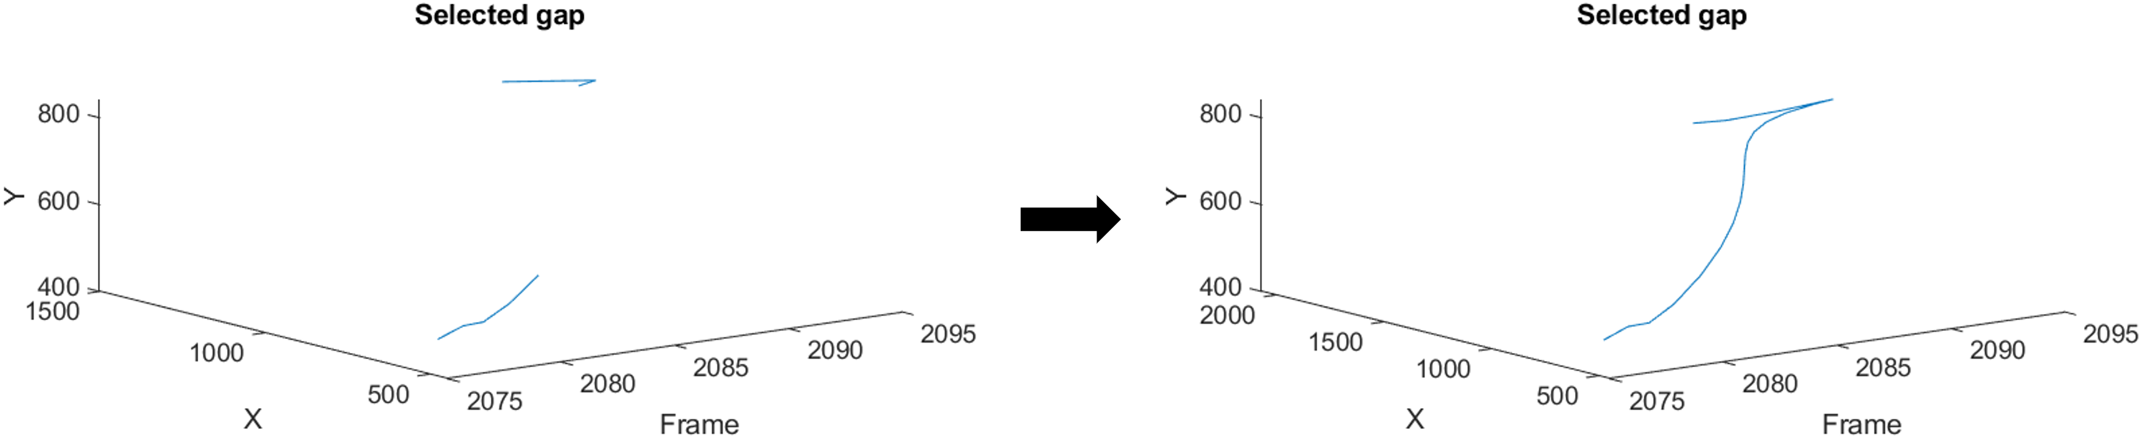
Fill gaps
Notes:
redundant

Slide 9
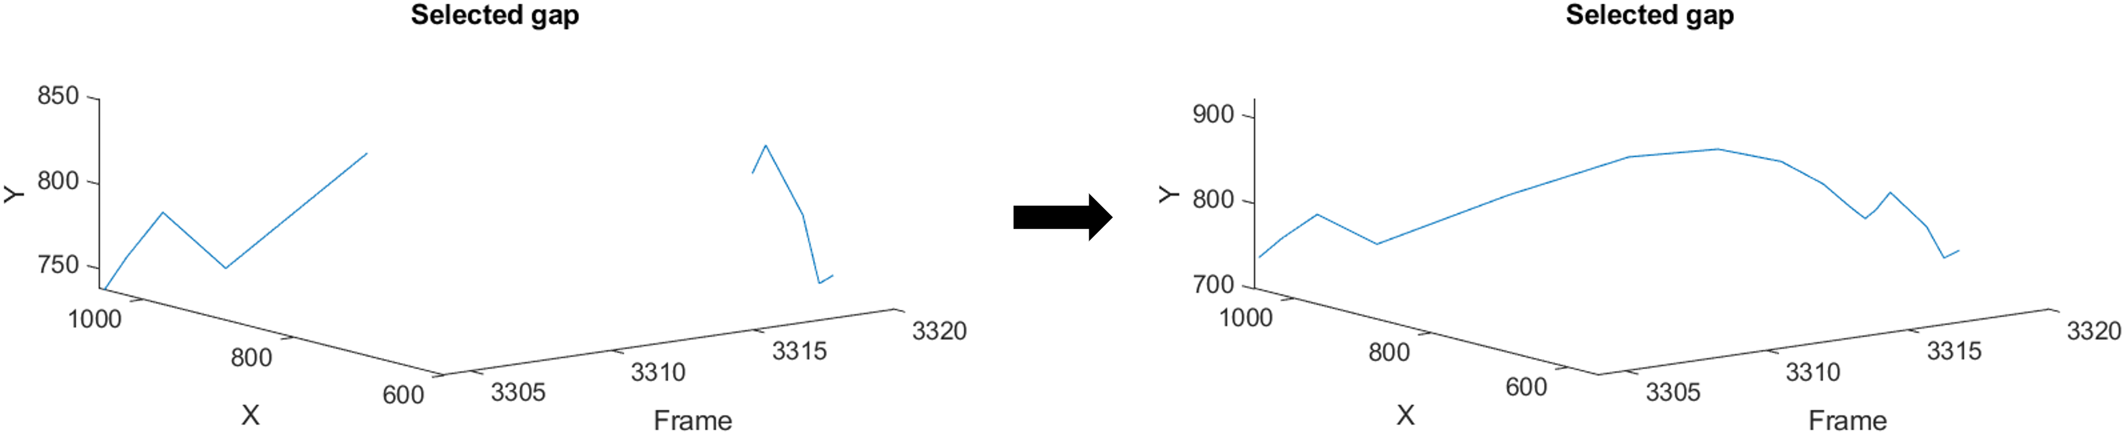
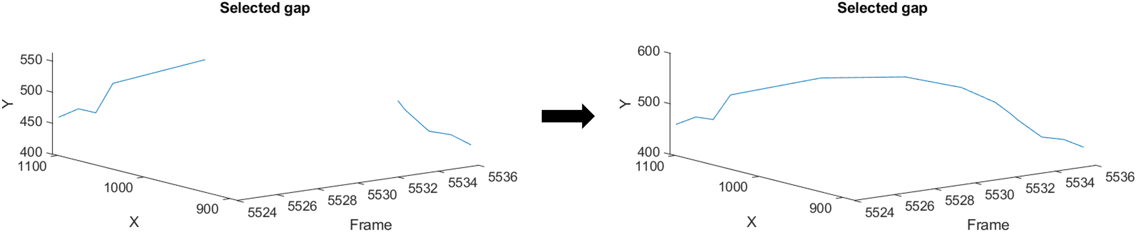
Fill gaps
Notes:
redundant

